Slide 2
Adding charging to smarticles
We do not want to open smarticles anymore
Always charging during experiment
Solar panels
Have a charging platform
Using an inductance charger or even charging points on bottom

Slide 3
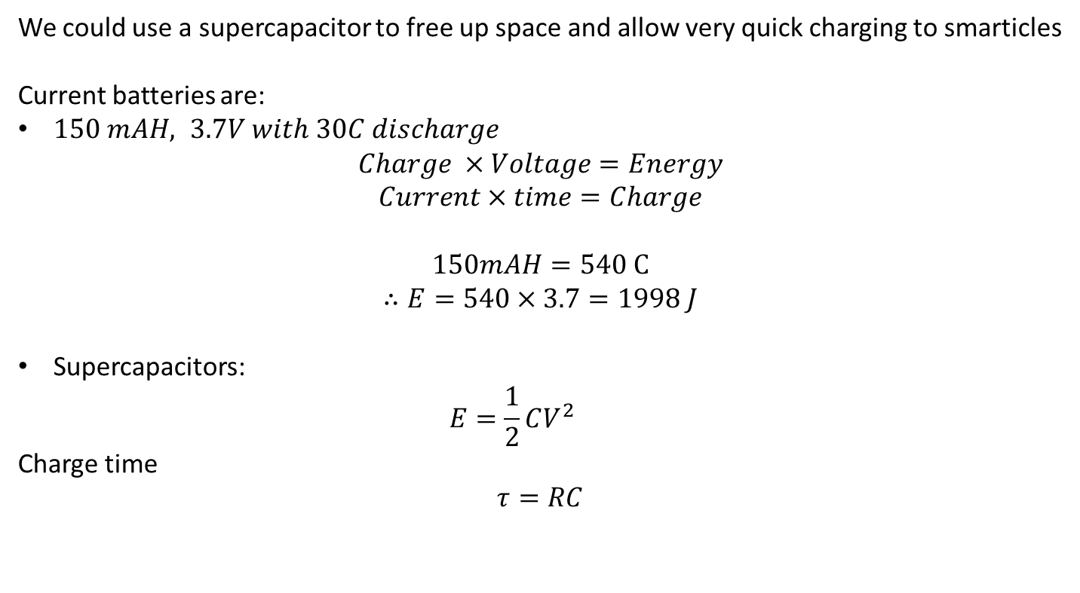
Charging battery designs
We could use a supercapacitor to free up space and allow very quick charging to smarticles
Current batteries are:
$150 mAH, 3.7V with 30C discharge$
$$Charge ×Voltage=Energy$$
$$Current×time=Charge$$
$$150mAH=540 C$$
$$∴E=540×3.7=1998 J$$
Supercapacitors:
$$E=\frac{1}{2}CV^{2}$$
Charge time
$$τ=RC$$
http://www.rc-electronics-usa.com/battery-electronics-101.html

Slide 4
Give smarticles ability to roll and turn
Adding flywheel to smarticles?

